Slide 1
Car Plate Recognition and Reconstruction with Deep Learning
Computer Vision 2024/25
Andrea Ciprotti Alessio Croce Simone Di Cocco

Slide 2
Outline
Problem Statement
State of the Art
Proposed Method
Dataset
Experimental Setup
Model Evaluation

Slide 3
Problem Statement
This project focuses on automatic license plate recognition using deep learning, a key application in traffic monitoring and smart mobility systems. The goal is to develop and evaluate models capable of accurately detecting and reconstructing license plates in challenging real-world conditions. The task includes implementing a baseline model, then replicating and testing the YOLOv5-PDLPR approach from current State of the Art [1], and finally comparing both models to assess improvements in performance.

Slide 4
State of the Art

Slide 5
Implementation in Two Stages
Stage 1: Image Detection with YOLOv5
This stage employs the YOLOv5 algorithm to identify and extract a cropped image containing the LP.
Stage 2: Image Recognition with PDLPR
Utilizing the cropped images from the previous stage, PDLPR is employed to identify the character sequence present within the LP.

Slide 6
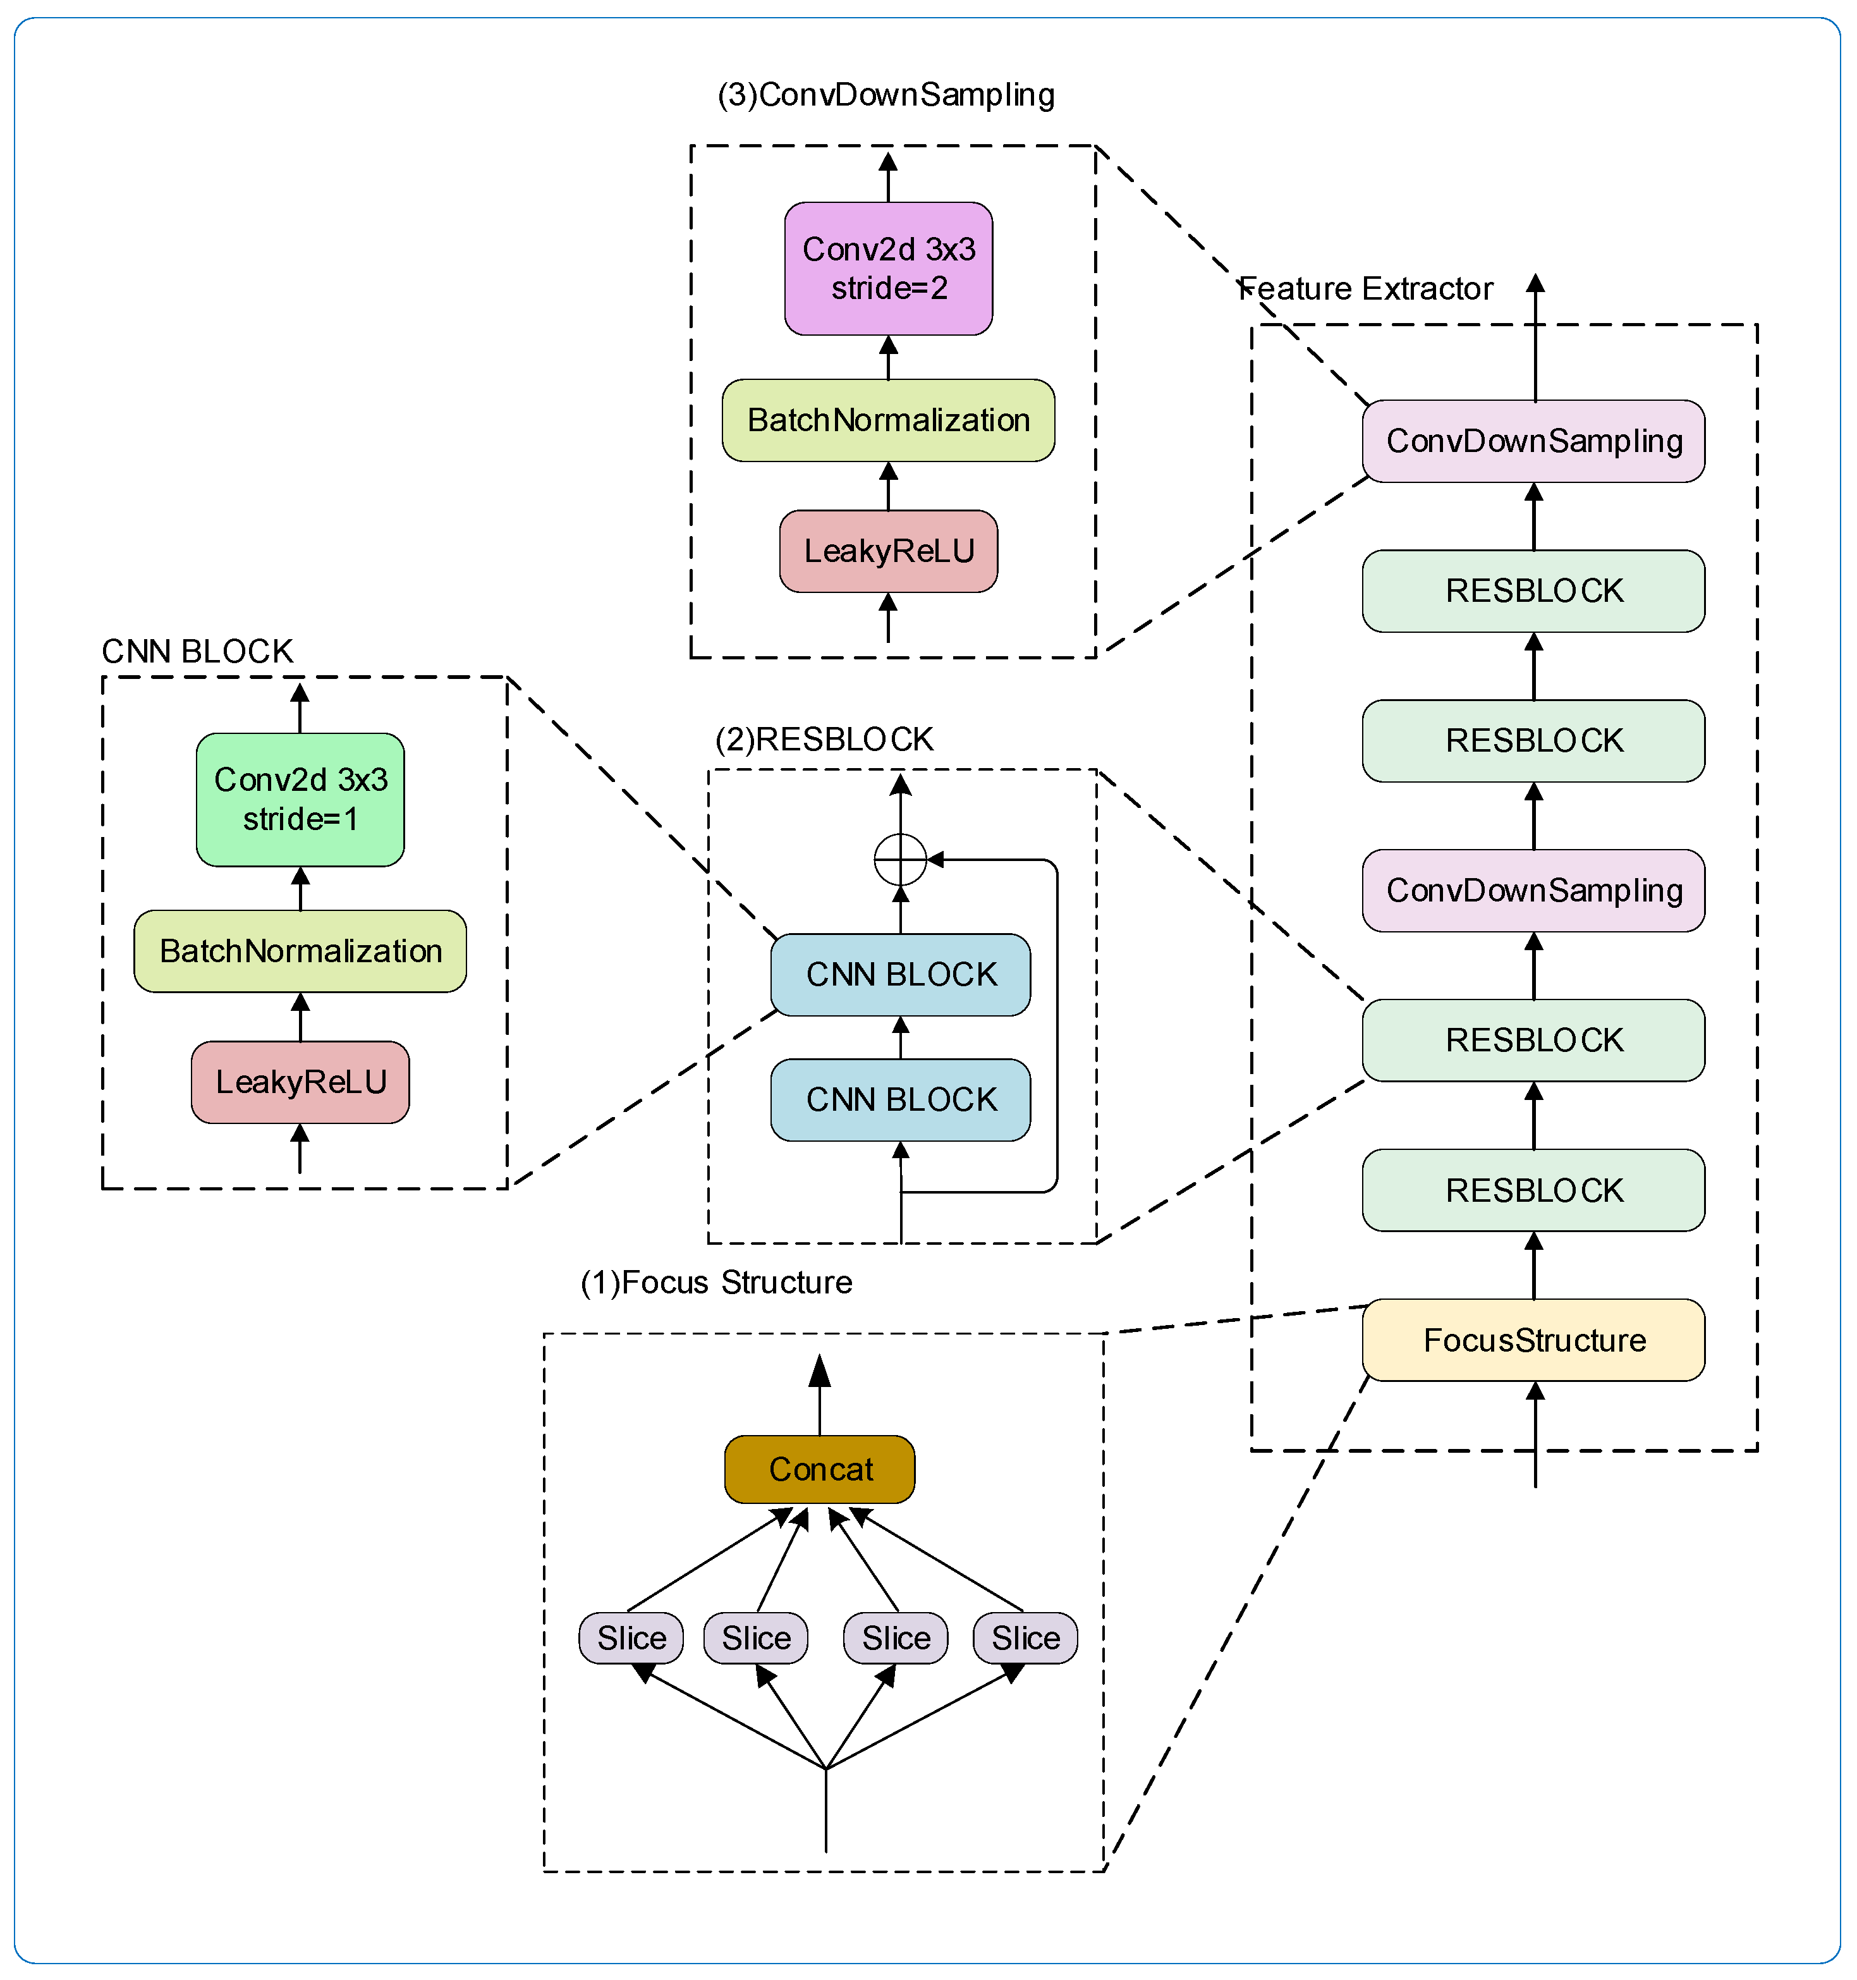
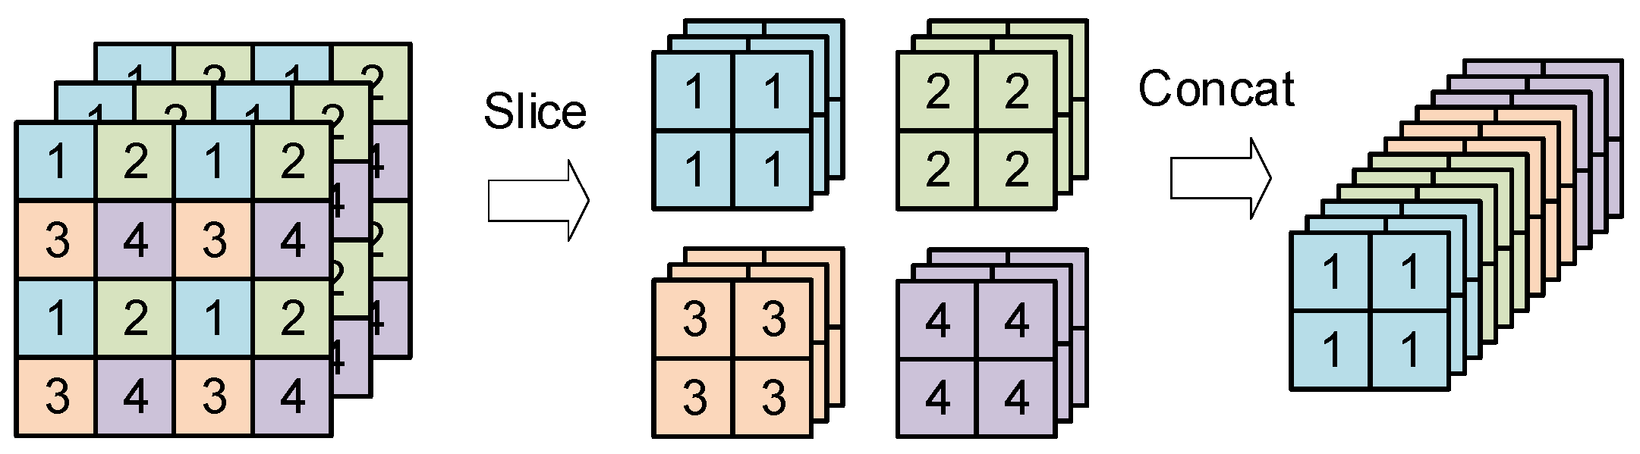
Improved Global Feature Extractor

Slide 7
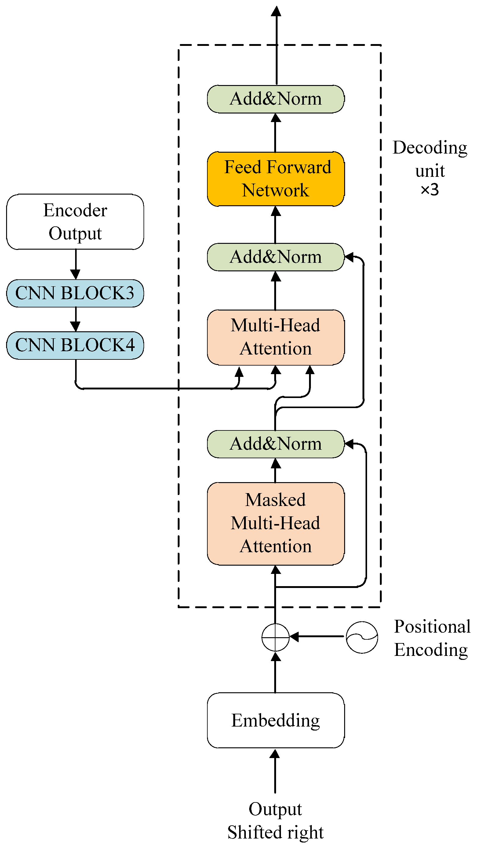
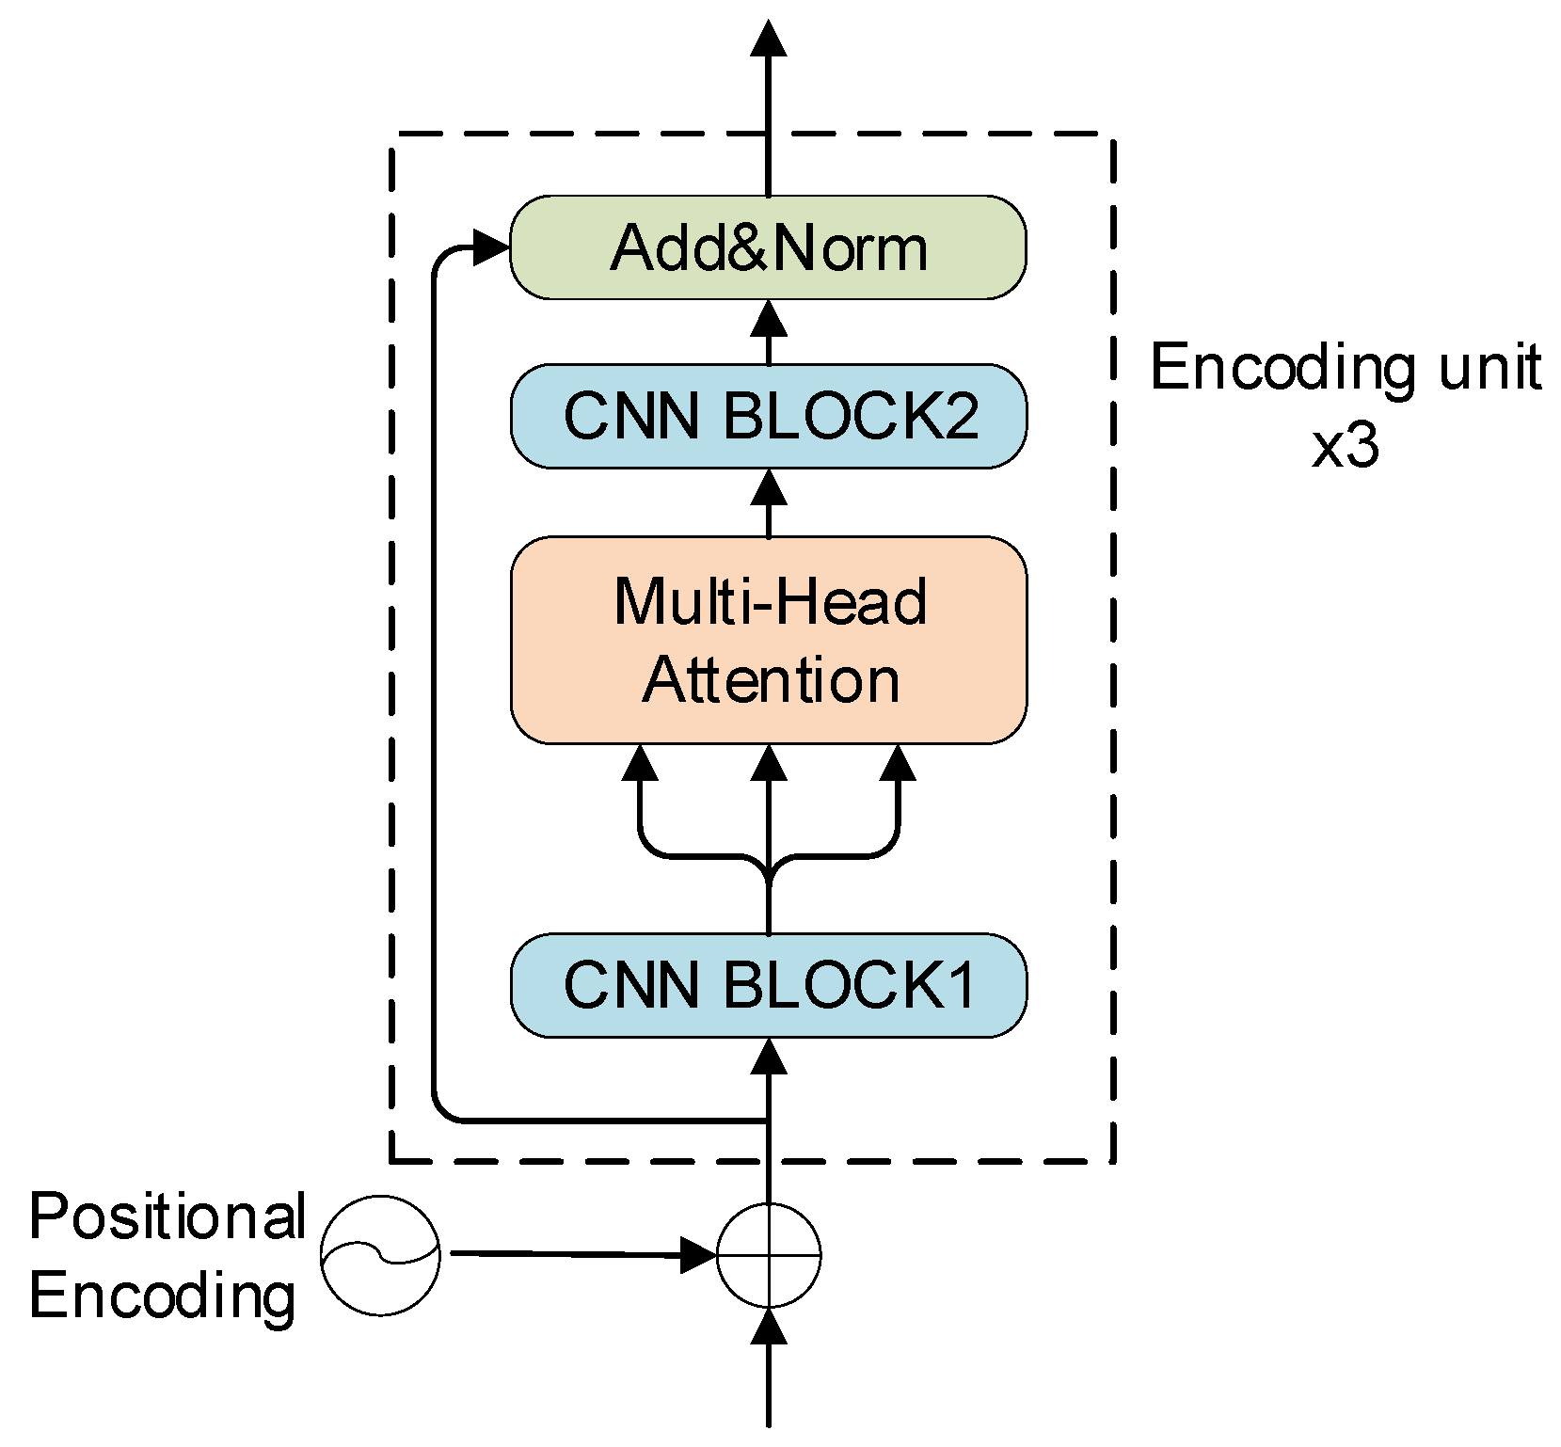
Encoder + Parallel Decoder

Slide 8
Proposed Method

Slide 9
All-in-One Model — A unified architecture that performs both license plate detection and recognition in a single pass.
Pre-trained ResNet18 as Feature Extractor
Bounding Box Head for Detection
Transformer Decoder for Sequence Prediction

Slide 10
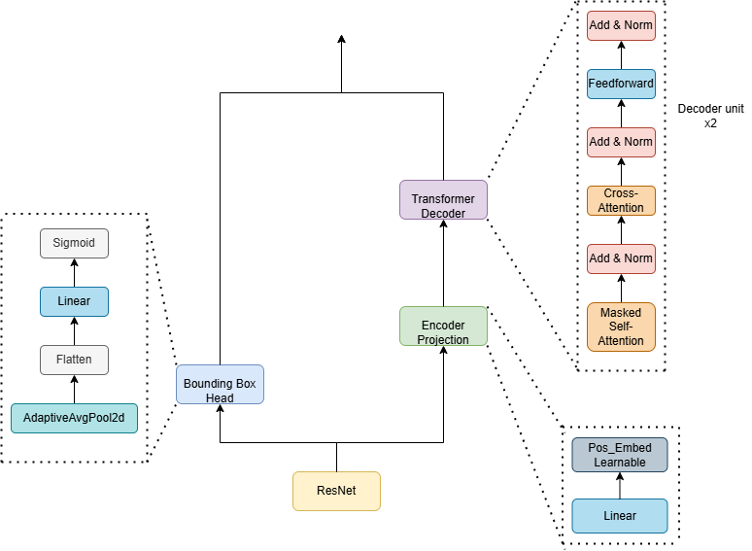
All-in-One Model

Slide 11
Dataset

Slide 12
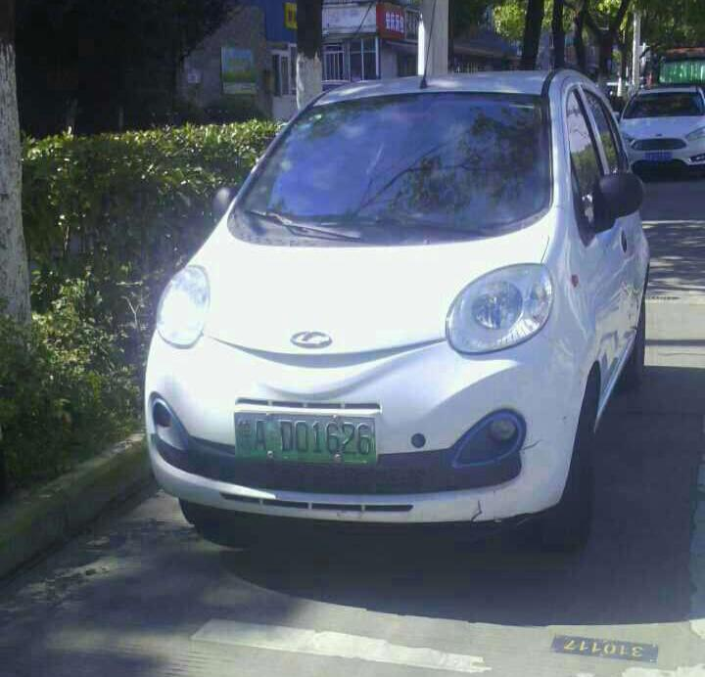
Dataset
We used an expansion of the CCPD Dataset [2] (CCPD green) with approximately 11,000 samples
The file name contains the label with information about the bounding box and the character sequence
Bounding Box Coordinates
(Top left - bottom right corners)
238&422_386&474
30077083333333333335-94_88-238&422_386&474-385&474_242&464_238&422_386&426-0_0_3_24_25_30_26_30-109-23.jpg
0_0_3_24_25_30_26_30
LP Character Sequence
(Encoded with alphabet dictionaries)

Slide 13
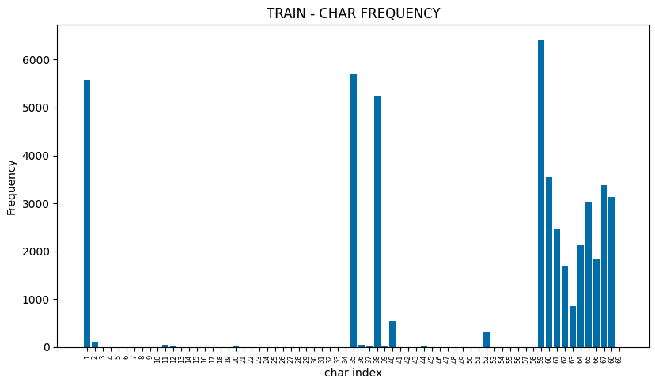
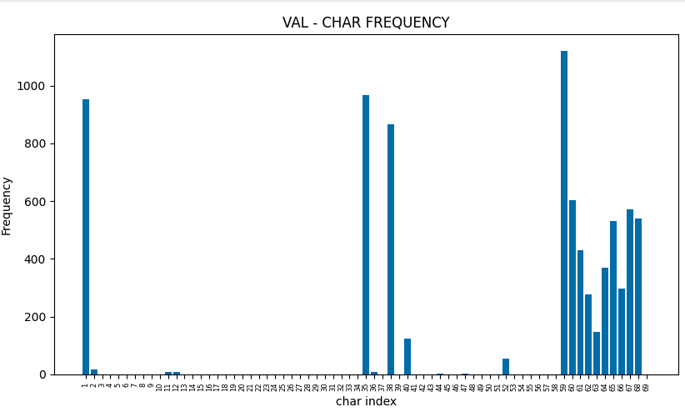
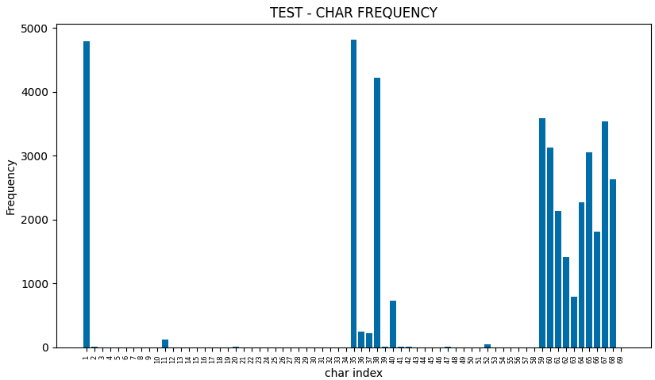
Dataset
As we can see, train, validation and test sets have different character distribution

Slide 14
Experimental Setup

Slide 15
State of the Art
Proposed Method
Detection
Image size: 640x640 px
Optimizer: Adam
Epochs: 300
Batch size: 50
Learning Rate: 1e-3
Scheduler: cosine annealing (min LR = 1e-5)
Recognition
Image size: 48x144 px
Optimizer: Adam
Loss function: CTC
Epochs: 1000
Batch size: 256
Learning Rate: 1e-4
Scheduler: reduce LR on plateau (factor 0.9)
Regularizations: weight decay, factor entropy, penalty, data augmentation
Hardware
Google Colab with Nvidia Tesla T4 GPU
Detection and Recognition
Image size: 640x640 px
Optimizer: Adam
Epochs: 700
Batch size: 18
Learning Rate: 1e-4
Scheduler: reduce LR on plateau (factor 0.9, min LR 5e-5)
Scheduled sampling (Teacher forcing, inference) [3]
Loss function: weighted loss function
Generalized Box IoU loss
Cross Entropy loss
Regularizations: weight decay, dropout, label smoothing, data augmentation
Hardware
Remote computer with Nvidia GeForce RTX 4050 Laptop GPU

Slide 16
Model Evaluation

Slide 17
Detection metrics
Recognition metrics
Accuracy, where a sample is correct if it has IoU greater than 0.7
Accuracy, where a sample is correct if its detection IoU was greater than 0.6 and every character in the sequence is recognized correctly
Results
 | State Of the Art | Proposed Method
Detection | 98.31 | 82.75
Recognition | 82.91 | 70.87

Slide 18
Conclusions

Slide 19
Future works
Hyperparameters Tuning
Pre-Training on a larger Dataset
Use the whole CCPD Dataset for training

Slide 20
References
[1] Tao, L., Hong, S., Lin, Y., Chen, Y., He, P. and Tie, Z. (2024). A Real-Time License Plate Detection and Recognition Model in Unconstrained Scenarios. Sensors, 24(9), 2791
[2] Xu, Z.; Yang, W.; Meng, A.; Lu, N.; Huang, H.; Ying, C.; Huang, L. Towards end-to-end license plate detection and recognition: A large dataset and baseline. In Proceedings of the European Conference on Computer Vision (ECCV), Munich, Germany, 8–14 September 2018.
[3] S. Bengio, O. Vinyals, N. Jaitly, and N. Shazeer, “Scheduled sampling for sequence prediction with recurrent neural networks,” in Proc. of NIPS, 2015.

